Slide 1
Day 2
Part-2
Explore Byte of Python
http://python.swaroopch.com/

Slide 2
Day 2
Part-3.1
Explore Scipy, NumPy, Matplotlib
Specialized libraries for python for various operations such as interpolation, optimization, linear algebra, signal processing, Fourier transformation, etc

Slide 3
Day 2
Part-3.2
http://www.scipy.org → Go to Documentation
http://www.numpy.org
http://matplotlib.org → for Plotting;
Go to Gallery and Examples

Slide 4
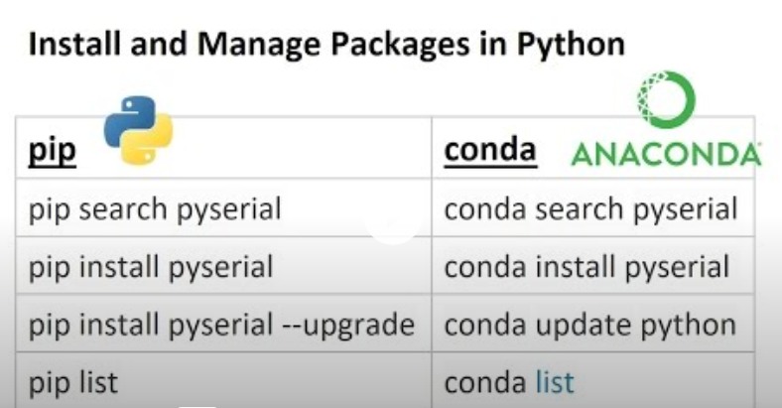
Day 2
Part-4 : Learn How to install Python packages
Go to Google

Slide 5
Thanks
Learning by Doing

